Slide 1

BLINKIT
SALES ANALYSIS DASHBOARD

Slide 2
Presented by: Amit Kumar Project: Data Analytics Capstone 01 Tools Used: Power BI | DAX | Data Modeling Description: Sales Analysis Dashboard An interactive Power BI dashboard created to analyze Blinkit grocery sales data and derive actionable business insights.

Slide 3
INTRODUCTION
The Blinkit Sales Analysis Power BI project aims to provide an insightful and interactive dashboard for analyzing sales performance across various dimensions.
This project will facilitate data-driven decision-making by visualizing key metrics, identifying trends, and uncovering actionable insights within Blinkit's sales data.
The project will empower stakeholders with valuable insights into sales performance, enabling informed decision-making and strategic planning.

Slide 4

OBJECTIVES
Visualize Sales Data: Create a comprehensive dashboard that visualizes sales performance metrics, including total sales, sales growth, and product performance.
Identify Trends: Analyze sales trends over time to help understand seasonal patterns and customer behavior.
Segment Analysis: Enable segmentation of sales data by geography, product categories, and customer demographics.
Performance Benchmarking: Compare current sales performance against historical data and predefined KPIs to evaluate business performance.

Slide 5
Dataset Overview
Data Set Used : Blinkit Grocery Dataset (Kaggle)
Key attributes include:
Item Identifier
Item Type
Item Fat Content
Item Visibility
Item Weight
Outlet Identifier
Outlet Size
Outlet Location Type
Outlet Establishment Year
Sales
Rating
Total records analyzed:
8523 product entries

Slide 6

KEY FEATURES
Interactive Dashboards: User-friendly interface with clickable visuals for
deeper analysis.
Customizable Reports: Ability to generate and export tailored reports
based on user-selected criteria.
Visualizations: Use of various visualization types, including bar charts, line graphs, pie charts, and heat maps to represent data effectively.
Filters and Slicers: Allow users to filter data by date ranges, product categories, regions, and other relevant dimensions.

Slide 7
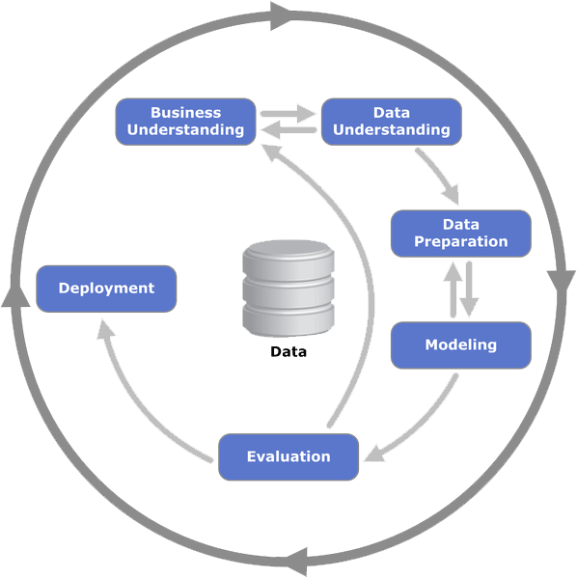
PROJECT PHASES
Requirement Gathering: Download the datasets from
Kaggle.
Data Preparation: Extract, clean, and transform data from
various sources to ensure accuracy and consistency.
KPI: Generate useful and insightful KPIs according to the
business requirement.
Dashboard Development: Build the Power BI dashboard with interactive features and visualizations based on the defined requirements.
.

Slide 8
DAX QUERIES
Metrics = This matrix is for the slicer that allow users to filter and analyze all relevant fields simultaneously, ensuring a comprehensive view of the data and facilitating deeper insights across different dimensions.
{
("Total Sales", NAMEOF('BlinkIT Grocery Data'[Total Sales]), 0), ("Avg Sales", NAMEOF('BlinkIT Grocery Data'[Avg Sales]), 1), ("Avg Rating", NAMEOF('BlinkIT Grocery Data'[Avg Rating]), 2), ("No of Items", NAMEOF('BlinkIT Grocery Data'[No of Items]), 3)
}

Slide 9

DAX QUERIES
KPIs :
Total Sales: The overall revenue generated from all items.
SUM('BlinkIT Grocery Data'[Sales])
Average Sales: The average revenue per sale.
AVERAGE('BlinkIT Grocery Data'[Sales])
Average Rating: The average customer rating for items sold.
AVERAGE('BlinkIT Grocery Data'[Rating])
Number of Items: The total count of different items sold.
COUNTROWS('BlinkIT Grocery Data')

Slide 10

PROJECTS INSIGHTS
Overall revenue is 1.20M.
Average revenue per sale on every item is $141.
Total 8523 items sold by different outlets at different location.
Items with Low fat content have the highest sales of 776.32K compared to regular fat i.e., 425.36K.
Medium sized outlet are at top in terms of revenue generation whereas high sized are at bottom.
Fruits and Vegetables are the most selling items with the sales of 178.12K.
Seafood is the least selling items with the value of only 9.08K.
Data reveals that sales reached their peak in 2018, highlighting it as the highest-performing year in terms of revenue generation.

Slide 11
Business Recommendations
Based on the analysis:
Increase stock for high-demand categories like fruits and snacks
Improve product visibility for underperforming items
Focus expansion in Tier 3 locations where sales are highest
Optimize inventory for low performing categories
Enhance marketing for products with high ratings but low sales

Slide 12
Conclusion
This dashboard provides a comprehensive analysis of Blinkit’s sales data.
By combining data visualization, DAX calculations, and interactive filters, the dashboard enables stakeholders to:
Monitor key sales metrics
Identify high performing products
Understand outlet performance
Make informed business decisions
The project demonstrates how Power BI can transform raw data into actionable insights.

